Slide 1
Extreme Risk Protection Orders [ERPOs]
Deputy City Attorney Keith A. Echterling – Prosecutor and TPD Legal Advisor
kechterling@cityoftacoma.org
(253) 591-5908

Slide 2
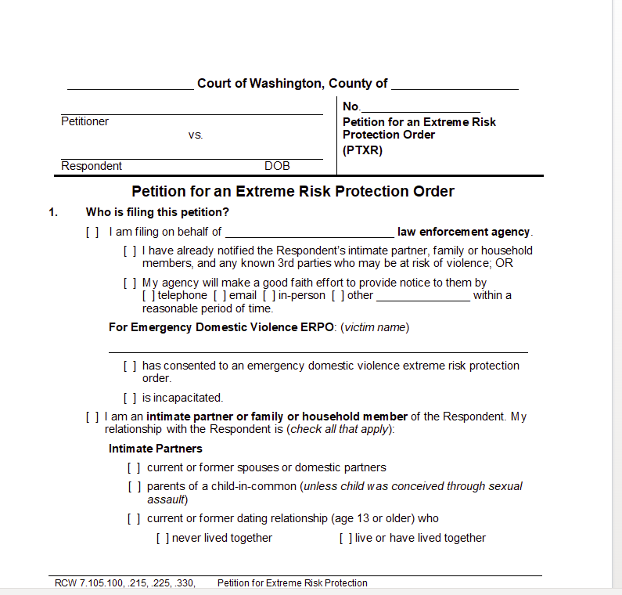
Protection Orders?
Civil Protection orders addressed under Chp. 7.105 RCW.
Extreme Risk Protection Orders fall into this category.
www.courts.wa.gov contains a variety of forms and resources for these (and other) petitions.

Slide 3
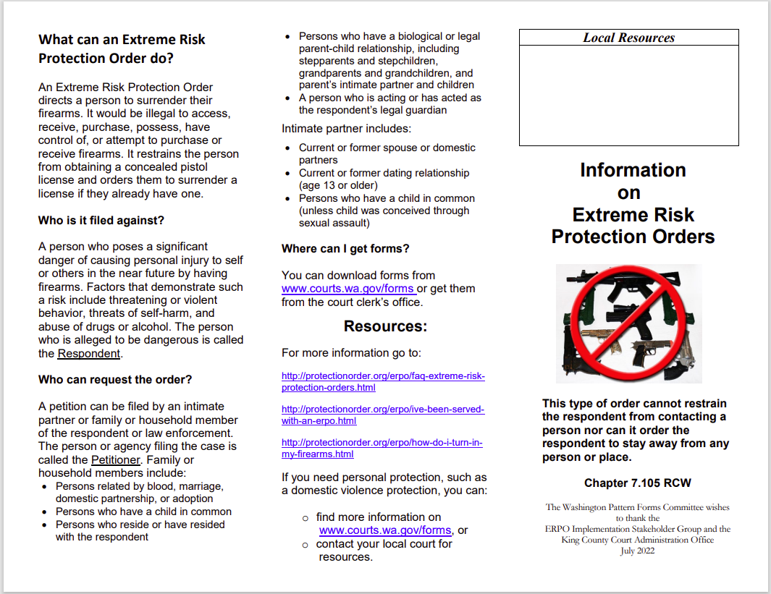
Brochure, pg. 1 from www.courts.wa.gov

Slide 4
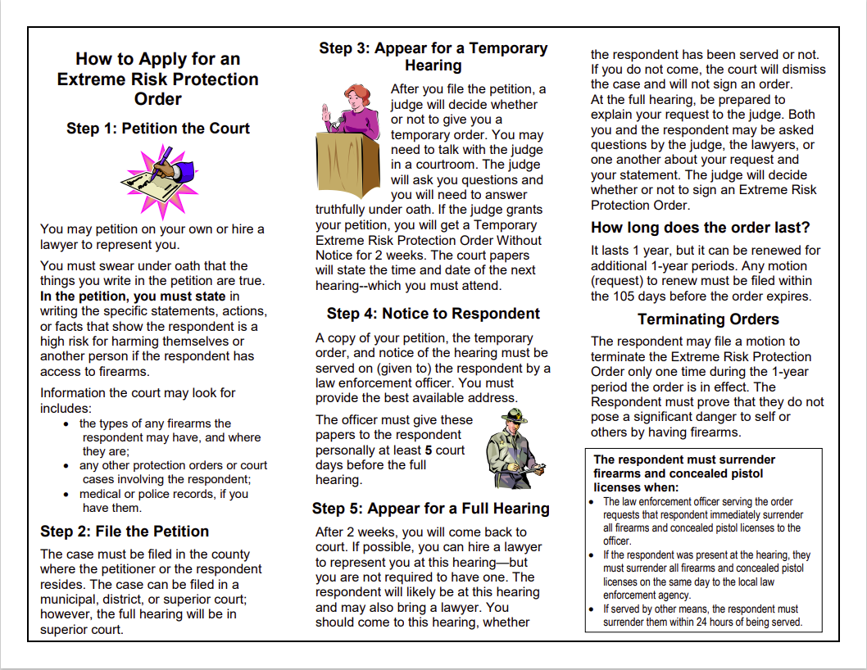
Brochure, pg. 2 from www.courts.wa.gov

Slide 5
Extreme Risk Protection Order
Petition for ERPO – RCW 7.105.100(1)(e).
“…must allege that the respondent poses a significant danger of causing personal injury to self or others by having in the respondent’s custody or control, purchasing, possessing, accessing, receiving, or attempting to purchase or receive, a firearm.” Id.
Petition must include facts petitioner can provide about number, types, and locations of firearms.
ERPOS can be filed by:
Intimate partner or Family or Household Member of Respondent; OR,
A law enforcement agency.

Slide 6
“Family or household members” RCW 7.105.010(13)
(a) Persons related by blood, marriage, domestic partnerhip, or adoption;
(b) persons who currently or formerly resided together;
(c) persons who have a biological or legal parent-child relationship, including stepparents and stepchildren and grandparents and grandchildren, or a parent’s intimate partner and children; and,
(d) a person who is acting or has acted as a legal guardian.

Slide 7
“Intimate partner” – RCW 7.105.010(2).
(a) Spouses or domestic partners;
(b) former spouses or former domestic partners;
(c) persons who have a child in common regardless of whether they have been married or have lived together at any time, unless the child is conceived through sexual assault; or,
(d) persons who have or have had a dating relationship where both persons are at least 13 years of age or older.

Slide 8
Law Enforcement Petitions?
LEO must make a good faith effort to notify intimate partner/family or household member/3rd party at risk of violence that LEO is/has petitioning/petitioned for ERPO;
Must include referrals to resources, such as behavioral health, DV, and counseling resources.
LEO must attest in petition to providing such notice or what steps will be taken for the notice.
Courts must allow LEO petitions for temporary ERPOs after-hours.
RCW 7.105.110.

Slide 9
ERPO Hearings – RCW 7.105.215
Ct. can hear testimony and ask questions of those involved;
Will make sure criminal history of respondent is checked;
Ct. can also consider whether ordering a behavioral health eval. for respondent is appropriate.
When considering ordering an ERPO, Ct. will consider any relevant evidence, including (but not limited to):
Recent acts/threats of violence [with or w/out firearm] and history of use of force;
Pattern of acts/threats of violence w/in past 12 months;
Behaviors presenting imminent threat of harm to self/others;
Any protection or NCO viols. by respondent?
Any ERPO viols.? And any prior arrest for felony or violent crime;
DV or Hate Crime convictions of respondent?
Ownership/access to firearms or intent to possess firearms and unlawful use of same, including recency of acquisition;
Corroborated evidence of alcohol/drug abuse.

Slide 10
Burden of Proof and standard
Petitioner must show by a preponderance of the evidence “that the respondent poses a significant danger of causing personal injury to self or others by having in the respondent’s custody or control, purchasing, possessing, accessing, receiving, or attempting to purchase or receive, a firearm.”
RCW 7.105.225(1)(e).

Slide 11
ERPOs
Ct. can issue a temporary ERPO and set a hearing to address ordering a full ERPO.
Full ERPO valid for one year, can be extended, and a respondent can move the Ct. to terminate the ERPO one time in every12-month period, including renewals.
If respondent meets his/her burden of proof re: termination (i.e., by a preponderance that he/she does NOT pose significant danger of harm to self/others), Ct. must terminate the ERPO.
Both temporary and full ERPOs require surrender of firearms.

Slide 12
Firearm Surrender - ERPOs
For temporary or full ERPOs the court shall order surrender of firearms and CPL of respondent.
For full orders, require law enforcement to revoke any CPL.
For service of ERPOs, LEO shall request surrender of firearms/CPL and conduct any lawful search for firearms.
If ERPO is ordered after a hearing, respondent must immediately surrender firearms/CPL on day of hearing to law enforcement – if respondent not present, and personal service by officer is not possible, surrender must occur 24 hours after alternate service.
Upon surrender, officer must issue receipt to respondent and file original with court w/in 72 hours after service of the order, keeping a receipt copy for the agency.
3-day compliance review hearing required (but can be waived if compliance w/surrender is shown).

Slide 13
Probable Cause – Fail to Surrender?
If Court determines there is PC that respondent has failed to surrender all firearms, Court shall issue warrant to search for and seize any firearms discovered.
Non-compliance can = contempt of court + sanctions.
Surrender and testimony re: surrender = non-admissible against respondent for certain criminal prosecutions.

Slide 14
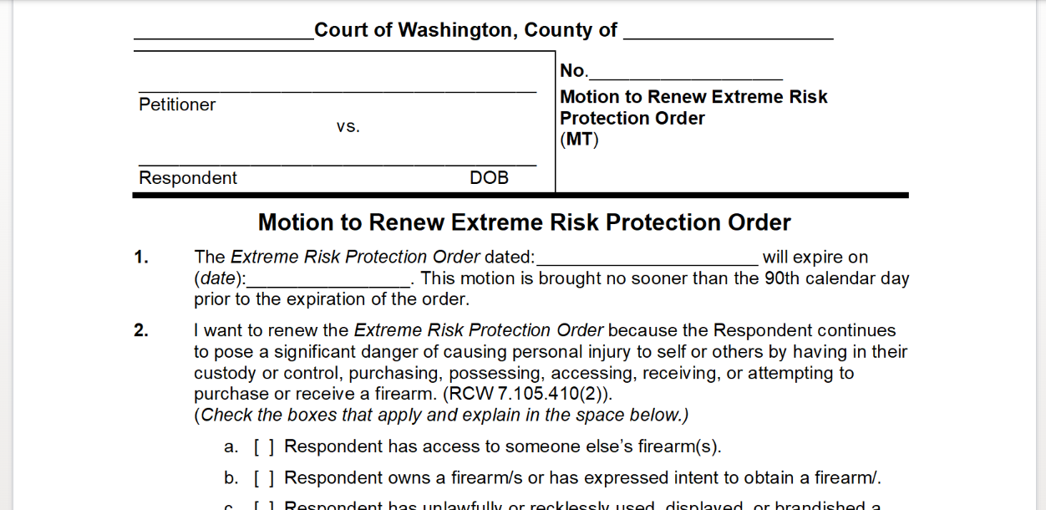
Renewals possible?
Ct. must notify petitioner 105 calendar days before order expires.
Petitioner can request a 1-year renewal of the order – Ct. will consider same process/evidence as required for an original full order (unless the motion is uncontested, then Ct. can rely on petitioner’s motion and proffered reason for renewal).

Slide 15
Enforcement and Penalties:
Gross Misdemeanor (364/$5,000 max): to file ERPO petition knowing info is materially false OR with intent to harass the respondent.
Gross Misdemeanor (364/$5,000 max): to violate terms of ERPO, knowing such exists, but having, receiving, etc… a firearm. Additionally, prohibited re: firearm possession, acquisition, etc… for an additional 5 years beyond expiration date of current ERPO.
Class C Felony (5yrs./$10K max): violation of ERPO w/2 prior ERPO convictions on record.

Slide 16
Other authority retained – RCW 7.105.570
“This chapter does not affect the ability of a law enforcement officer to remove a firearm or concealed pistol license from any person or to conduct any search and seizure for firearms pursuant to other lawful authority.”
Consent;
Warrant;
Warrant exception such as plain view, exigent circumstances, search incident to arrest, etc….

Slide 17
Legislative Findings – RCW 7.105.900(3)(f)

